Slide 1

Agent Activity Chart
8/28/2023 12:42 AM
Print User : selenium.automation
Page 1 of 3

Slide 2
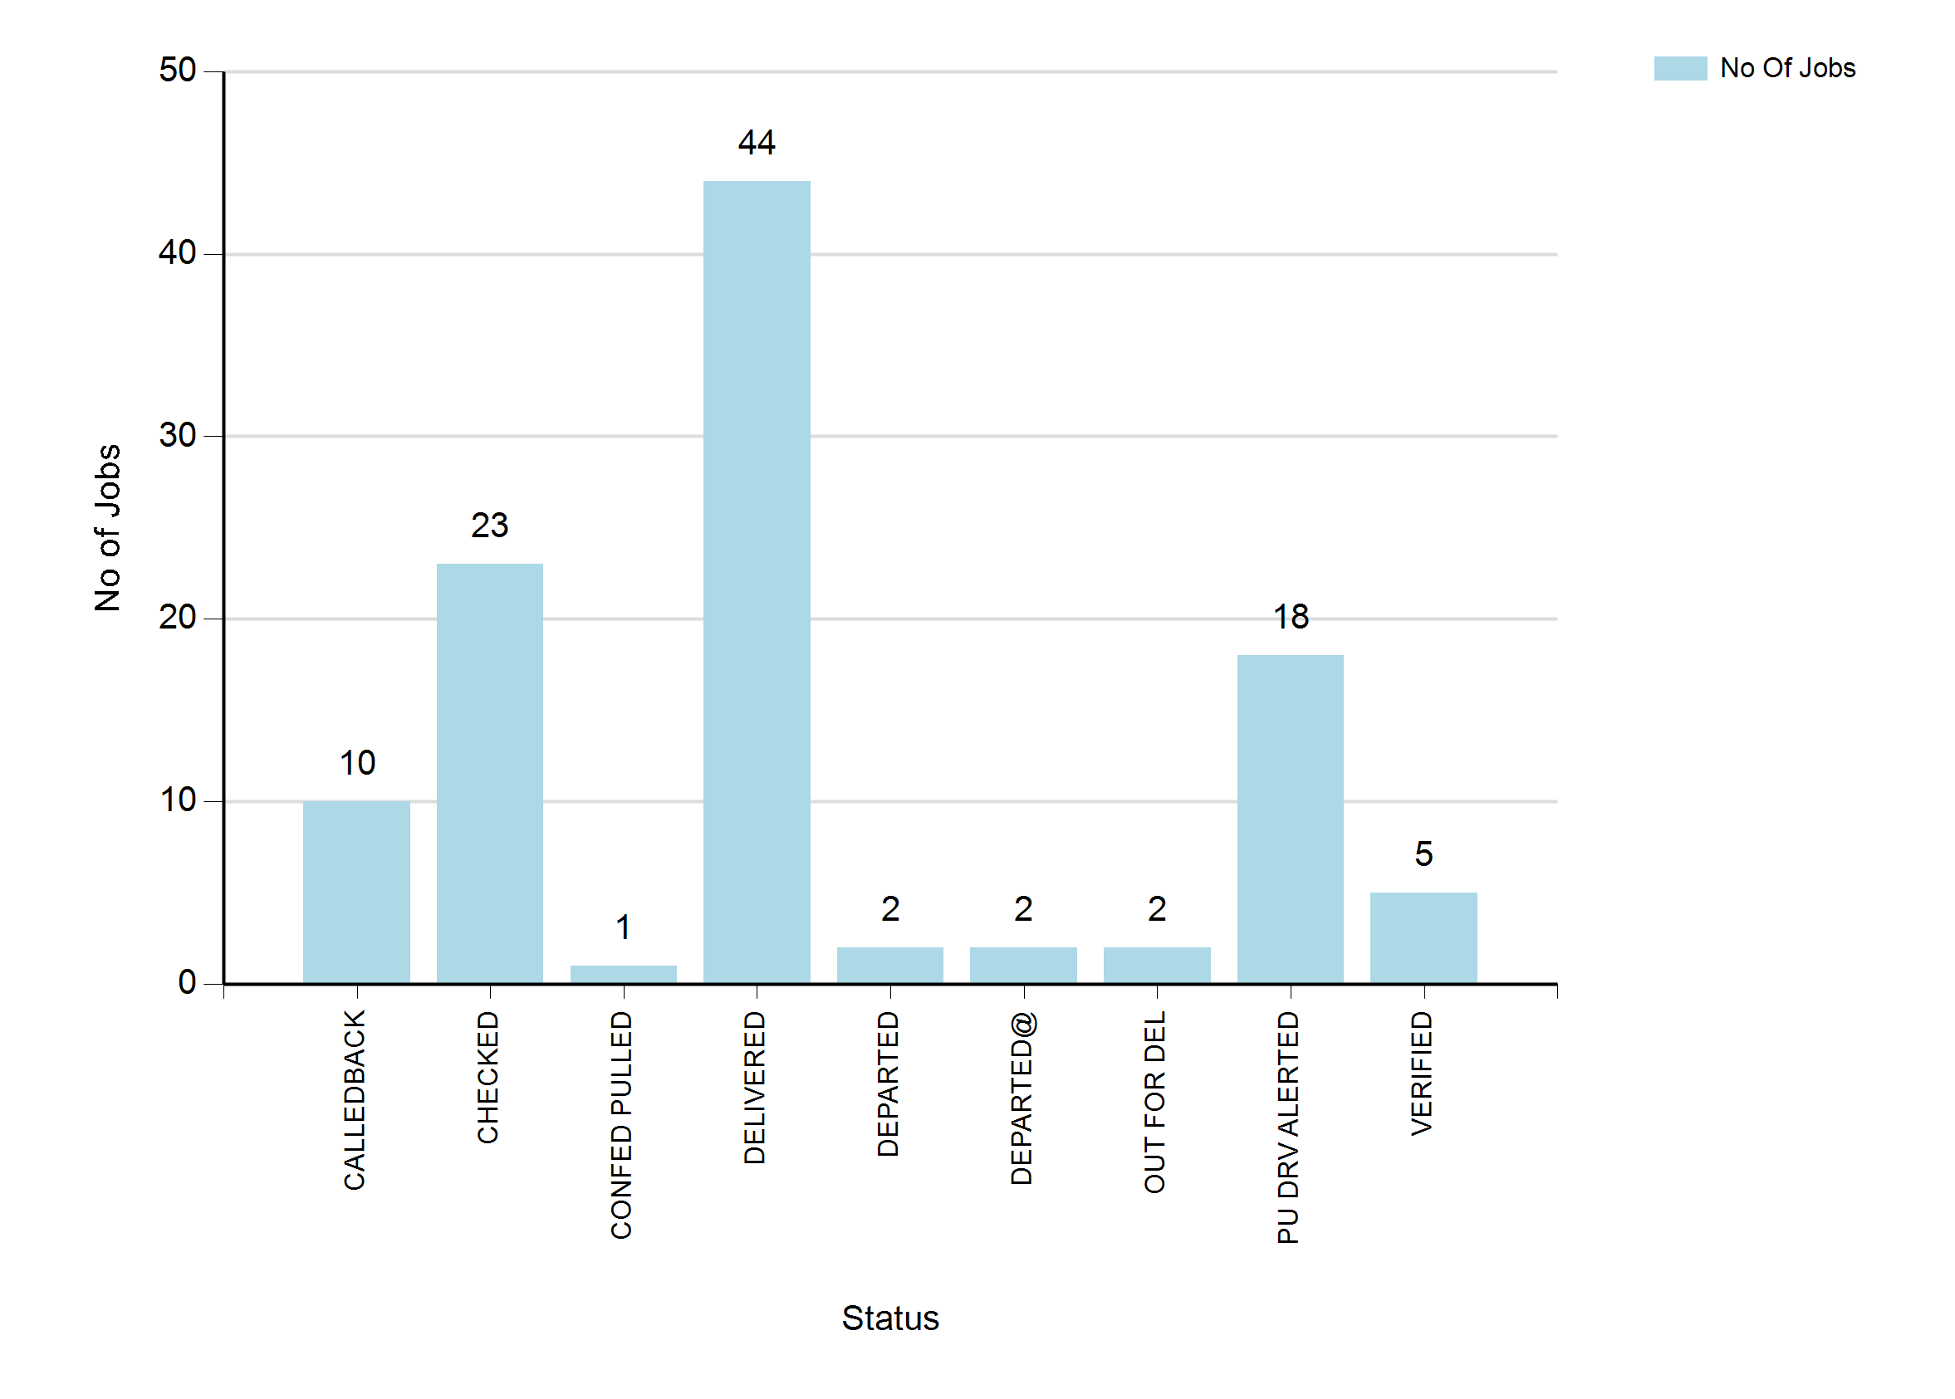
8/28/2023 12:42 AM
Print User : selenium.automation
Page 2 of 3

Slide 3
8/28/2023 12:42 AM
Print User : selenium.automation
Page 3 of 3

